Slide 1
Test design
Svyatoslav Dyuhanchuk

Slide 2
Test design techniques
Dynamic
Static

Slide 3
Types
Static Testing | Dynamic Testing
Testing done without executing the program | Testing done by executing the program
Static testing is about prevention of defects | Dynamic testing is about finding and fixing the defects
Static testing involves checklist and process to be followed | Dynamic testing involves test cases for execution
This testing can be performed before compilation | Dynamic testing is performed after compilation
Cost of finding defects and fixing is less | Cost of finding and fixing defects is high
Requires loads of meetings | Comparatively requires lesser meetings

Slide 4
Test design techniques - Static
Static analysis
Informal review
Walkthrough
Technical review
Inspection
Called prevent errors.
They do not require direct use software.

Slide 5

Informal review
This is one of the type of review which doesn't follow any process to find errors in the document. Under this technique, you just review the document and give informal comments on it.
Static Analysis
Control Flow Structure
Data Flow Structure

Slide 6

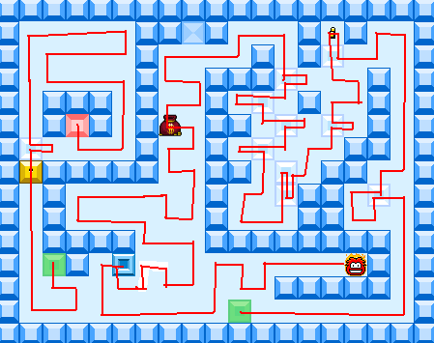
Walkthrough
Technical review
Walkthrough: The author of the work product explains the product to his team. Participants can ask questions if any. Meeting is led by the author. Scribe makes note of review comments.
This review concentrates mainly on the technical document related to the software such as Test Strategy, Test Plan and requirement specification documents.

Slide 7

Inspection
The main purpose is to find defects and meeting is led by trained moderator.
This review is a formal type of review where it follows strict process to find the defects.
Reviewers have checklist to review the work products .They record the defect and inform the participants to rectify those errors.

Slide 8
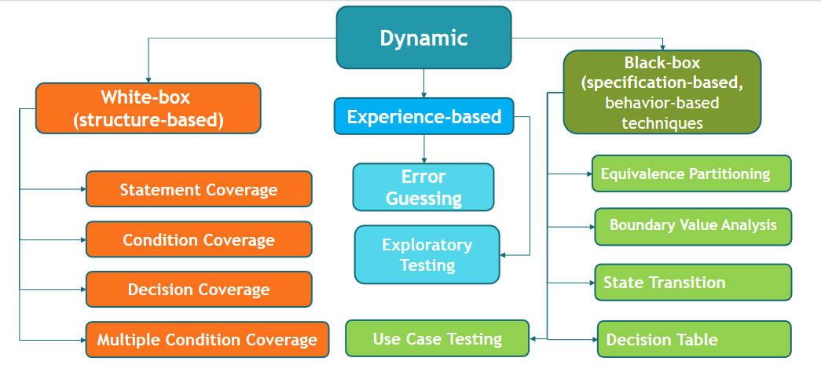
Dynamic testing

Slide 9
Test design techniques – Structure based
Statement (Line)
Decision (Branch)
Path

Slide 10
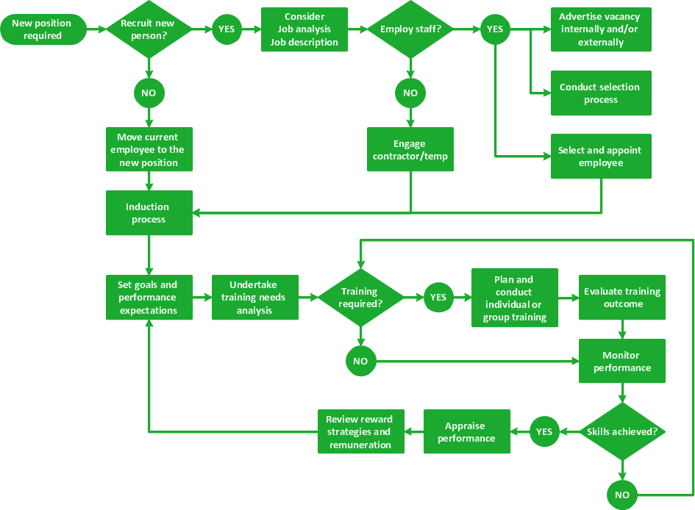
Test design techniques – Structure based

Slide 11
Test design techniques – Spec. based
Equivalence partitioning
State transition
Use case testing
Boundary value analysis
Decision table

Slide 12
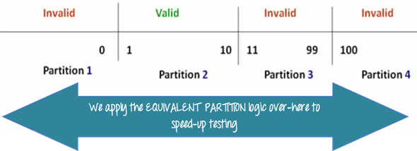
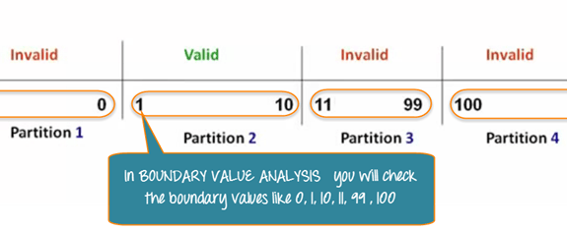
Test design techniques – equivalence partitioning
Test design techniques – Boundary values

Slide 13
Test design techniques – Decision table
Customer can take a loan in a bank.
The bank gives loan application, where customer can enter the amount of the monthly re-payment or the number of years customer wants to take to pay it back (the term of the loan).
Customer should infill only one of the proposed fields.
If customer enter both, then customer will get an error message.
Also customer can choose a discount which helps reduce %.

Slide 14
Test design techniques – Decision table
Conditions | Rules 1 | Rules 2 | Rules 3 | Rules 4 | Rules 5 | Rules 6 | Rules 7 | Rules 8
Month | Y | Y | Y | Y | N | N | N | N
Year | Y | Y | N | N | Y | Y | N | N
Discount | Y | N | Y | N | Y | N | Y | N
Actions
Result |  |  | M+D | M | Y+M | Y
Error | Y | Y |  |  |  |  | Y | Y

Slide 15

Test design techniques – State transition
Customer chooses Arabica coffee from coffee machine.
He selects specific sort of coffee (in this case Arabica), and enters money.
If Arabica coffee is available, then machine will check money.
If Arabica coffee is not available, then customer will get proper message and his money back.
If not enough money is entered, then machine will ask to enter more.
If amount of money is OK, then customer will get coffee and his change in a minute.

Slide 16
Test design techniques – State transition

Slide 17
Test design techniques – Use case
Actor
Check credit card balance
Withdraw cash
Pay bills

Slide 18
Types
Static Testing | Dynamic Testing
Testing done without executing the program | Testing done by executing the program
Static testing is about prevention of defects | Dynamic testing is about finding and fixing the defects
Static testing involves checklist and process to be followed | Dynamic testing involves test cases for execution
This testing can be performed before compilation | Dynamic testing is performed after compilation
Cost of finding defects and fixing is less | Cost of finding and fixing defects is high
Requires loads of meetings | Comparatively requires lesser meetings

Slide 19


